Slide 1
Juke Box
CapStone Project
by Avinash raj V
Guidence by
Mrs . Puspa Rani
Mr . Vaibhav Diwan

Slide 2
JukeBox
A jukebox is a partially automated music-playing device, usually a coin-operated machine, that will play a patron's selection from self-contained media.
Now we have created modern created jukebox.Here we can do,
Display songs.
Search song by Song Names ,artist Name ,Genre to play songs.
Create Playlist,View playlist.

Slide 3
Pages We have
It Perform to
Search songs to play
Create a playlist to add songs,view playlist to play songs
Techinical Codes Used:
Java,Mysql

Slide 4
About Java And MySQL
Java:
Java Code is open source platform .
It is designed to be easy to learn and use, and is used for developing enterprise applications, web applications, mobile applications and more.
It allowing developers to write code once and run it anywhere.
In this juke box program it can perform play song resume,pause,replay and stop.
it used to create playlist to add songs and view song and play songs.
Using this command to connect MySQl
connection = DriverManager.getConnection("jdbc:mysql://localhost:3306/blissmusic","root","1234");
Then to get data from MySQL database and we can use data to perform play function and add playlist and view play list.
MySQL:
MySQL is an open-source relational database management system (RDBMS).
It is used to store, organize, and retrieve data from a database.
In this Juke Box Project it can be to store songs and create table and displays songs.

Slide 5
Functions Used in :
In Java:
IF ELSE
SWITCH CASE
METHODS
PACKAGES
DB CONNECTION
EXCEPTIONAL HANDLING
LOOPS
CONSTRUCTORS
GETTER & SETTERS
In MySQL:
Create Database
Create Table
Insert Variables
Show table

Slide 6
In Java Platform packages:
Java (main) :
java.jukebox
model :
song
playlist
DAOImpl :
AudioPlay
createPlaylist
main
music
musicDetail
musicImpl
connection :
getConnection

Slide 7
In AudioPlay class :
In audio play:
It can be to perform song play , pause , resume , next ,replay and stop songs.
Functions:
Play :
It use be to play the current song from the file path.
Pause :
It used to be to pause the current song.
Resume :
It use to resume to pause song.
Replay :
it use to be play again the current songs.
Next :
It use to play next song.
Stop:
It use to stop the songs.

Slide 8
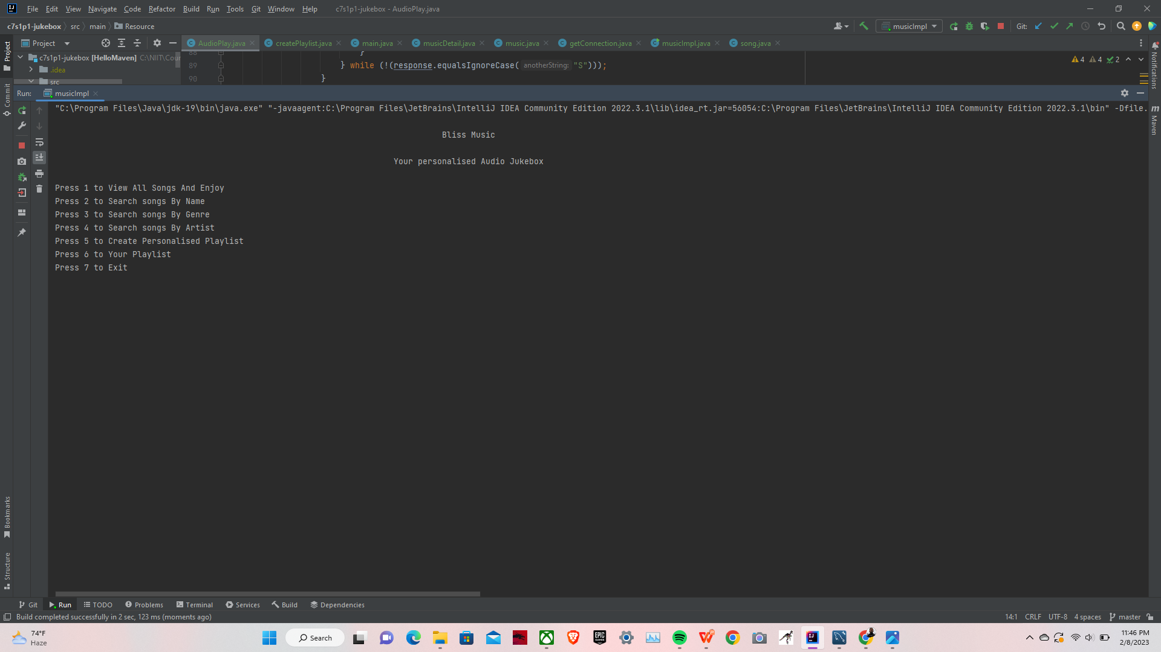
To View Options
Its show menu of View All Songs ,
Search songs By Name,
Search songs By Genre,
Search songs By Artist,
to Create Personalised Playlist,
to Your Playlist.
press1 all songs are displayed
all songs to play
press 2 for search song name, 3
for search genre an, 4 for searchArtist,5 for create playlist , 6 for view playlist and 7 for exit

Slide 9
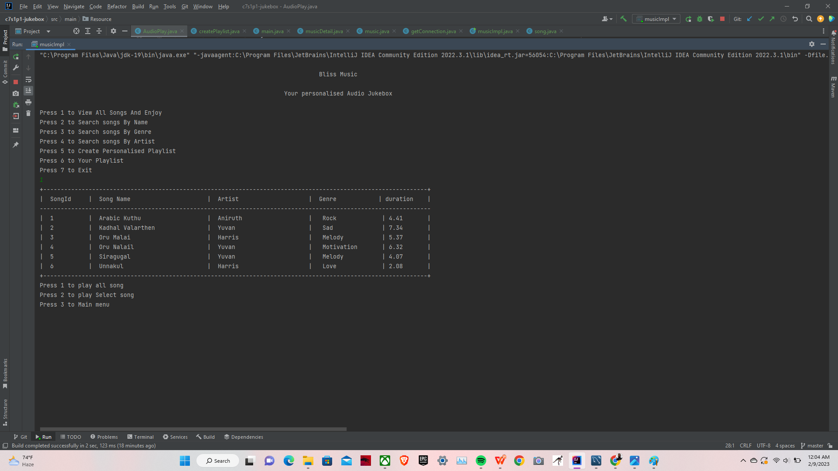
Display all Songs and Play Selected Song
press1 for display all songs
we can able to choose songs
which user have to be asked to
play.

Slide 10
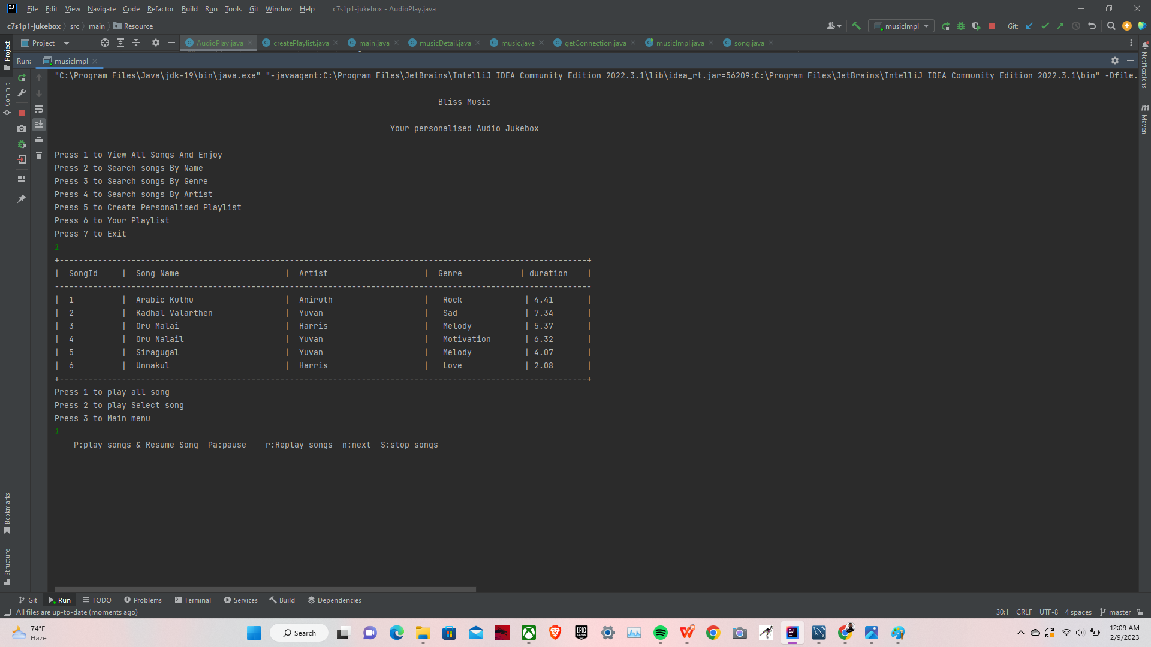
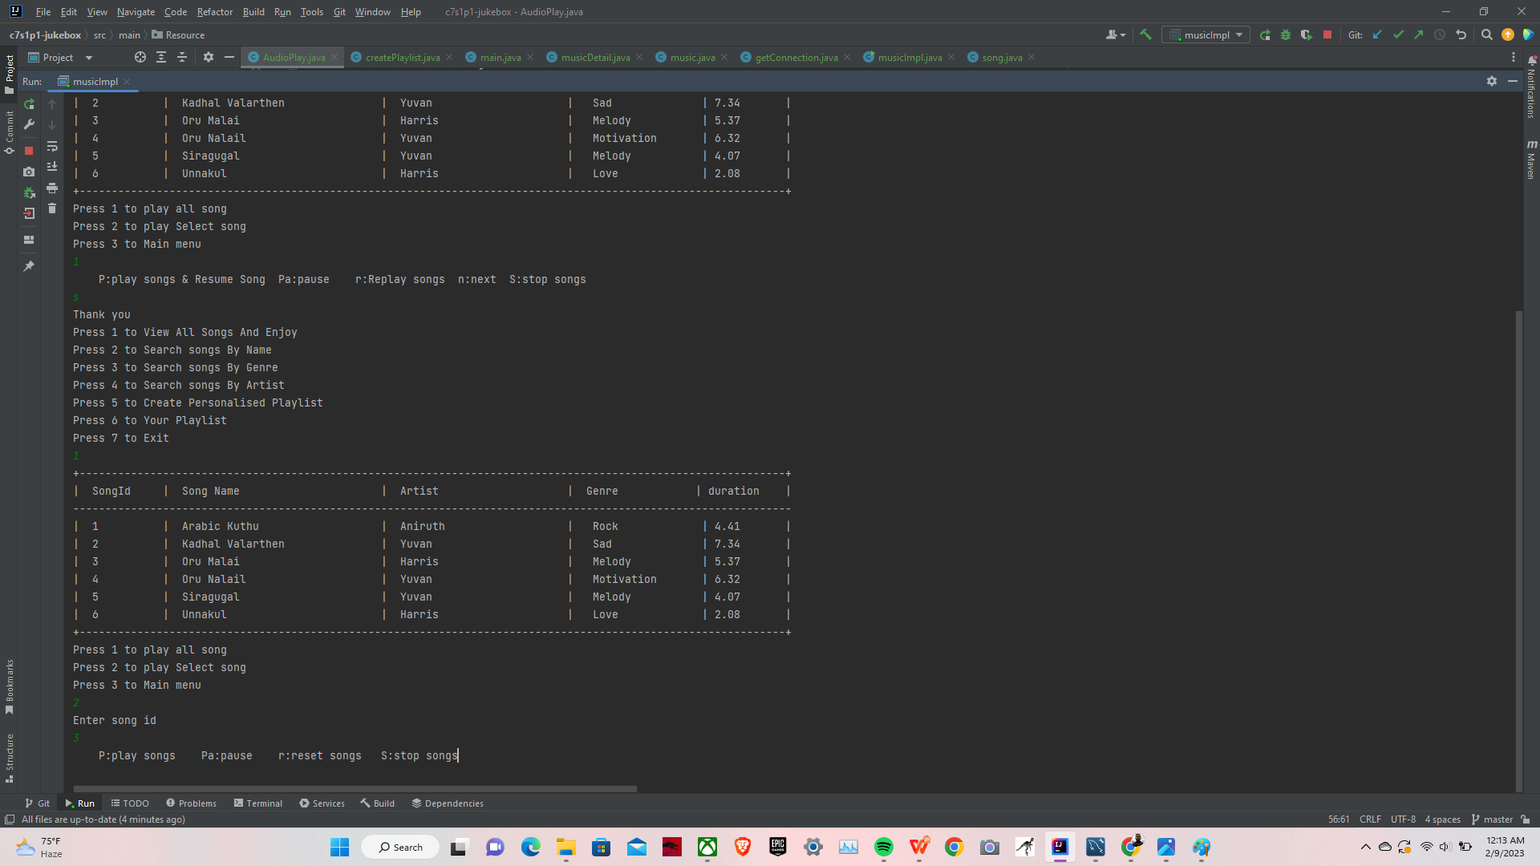
play all song and selected song
After press 1 we can play all songs
the songs are played continusly as per the given list.
there will be the options to play,pause,replay songs,to play next song and stop songs.
and press 2 for to select selected song for
all song . Enter song id it can be to play a selected song

Slide 11
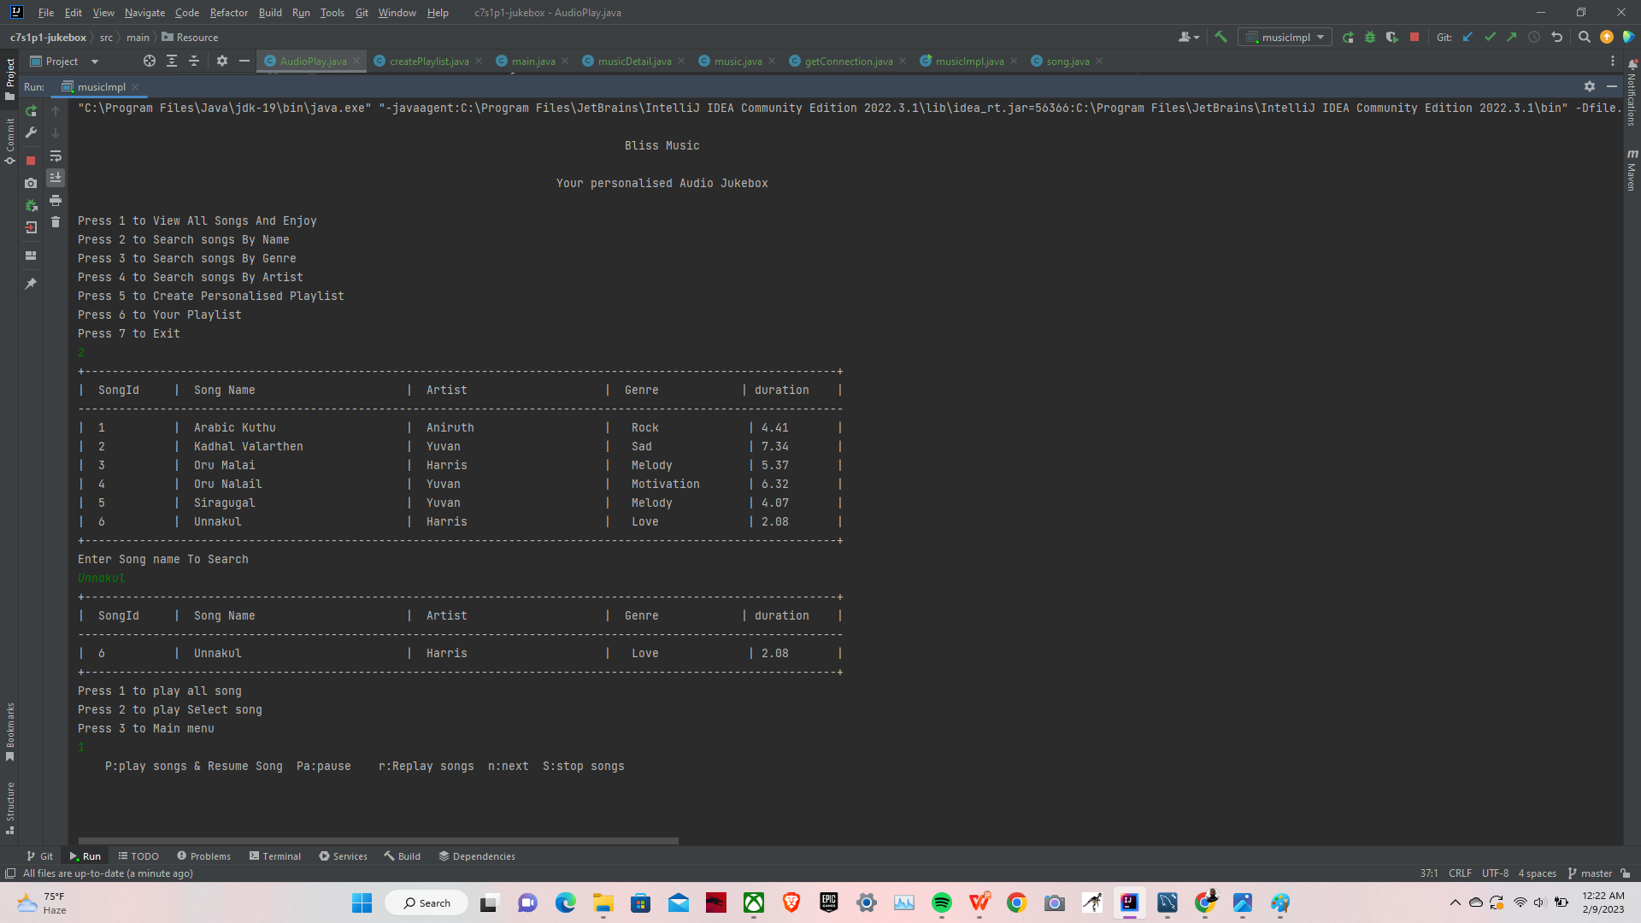
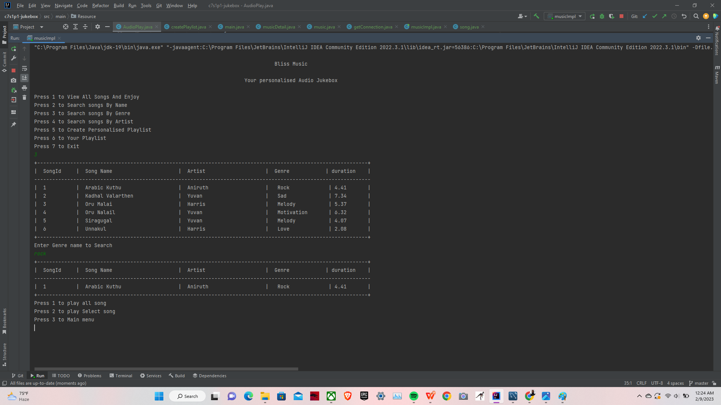
Search Songs by Artist ,Song name and Genre
To search songs by name,genere,artist.
By giving genre Song name,by artist name and Genre name. if it is given the list is sorted as per the request
The given image Show example for search name, artist name , genre name.

Slide 12
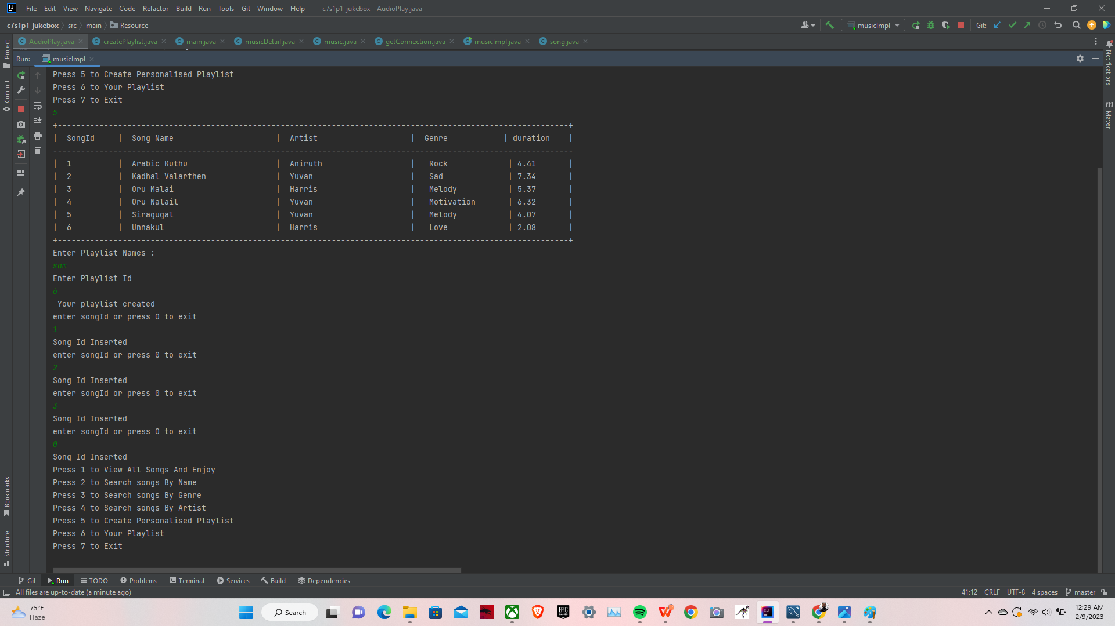
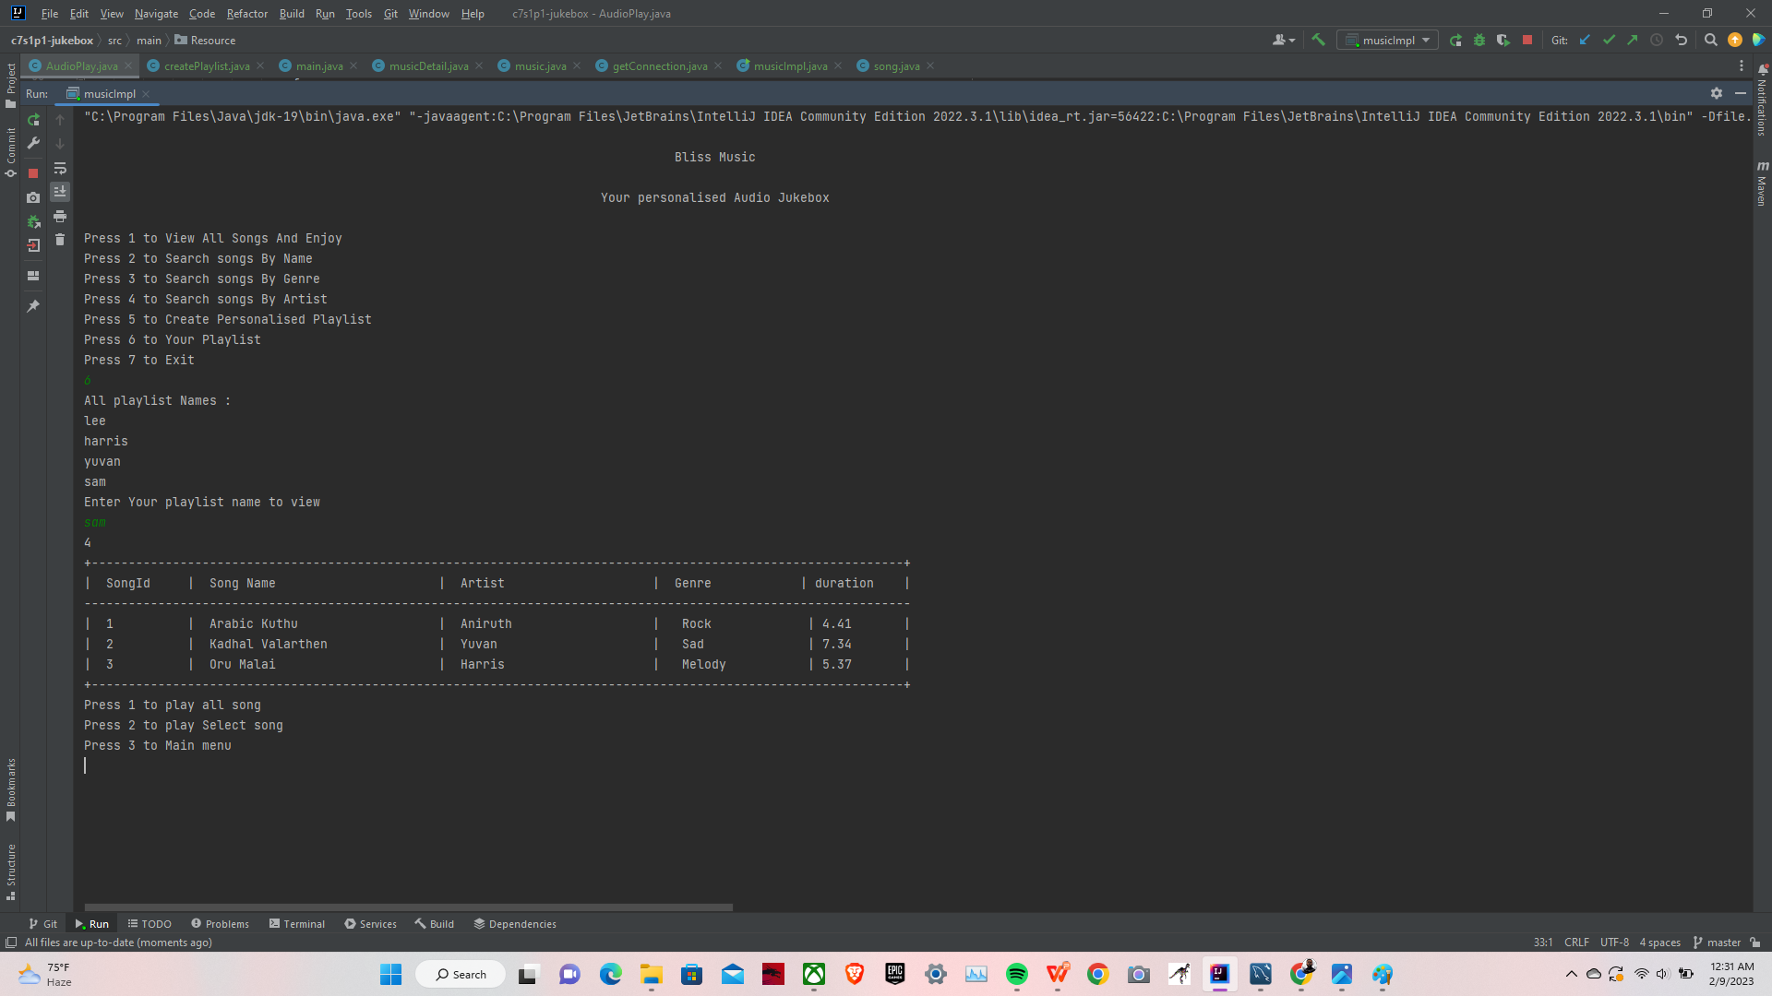
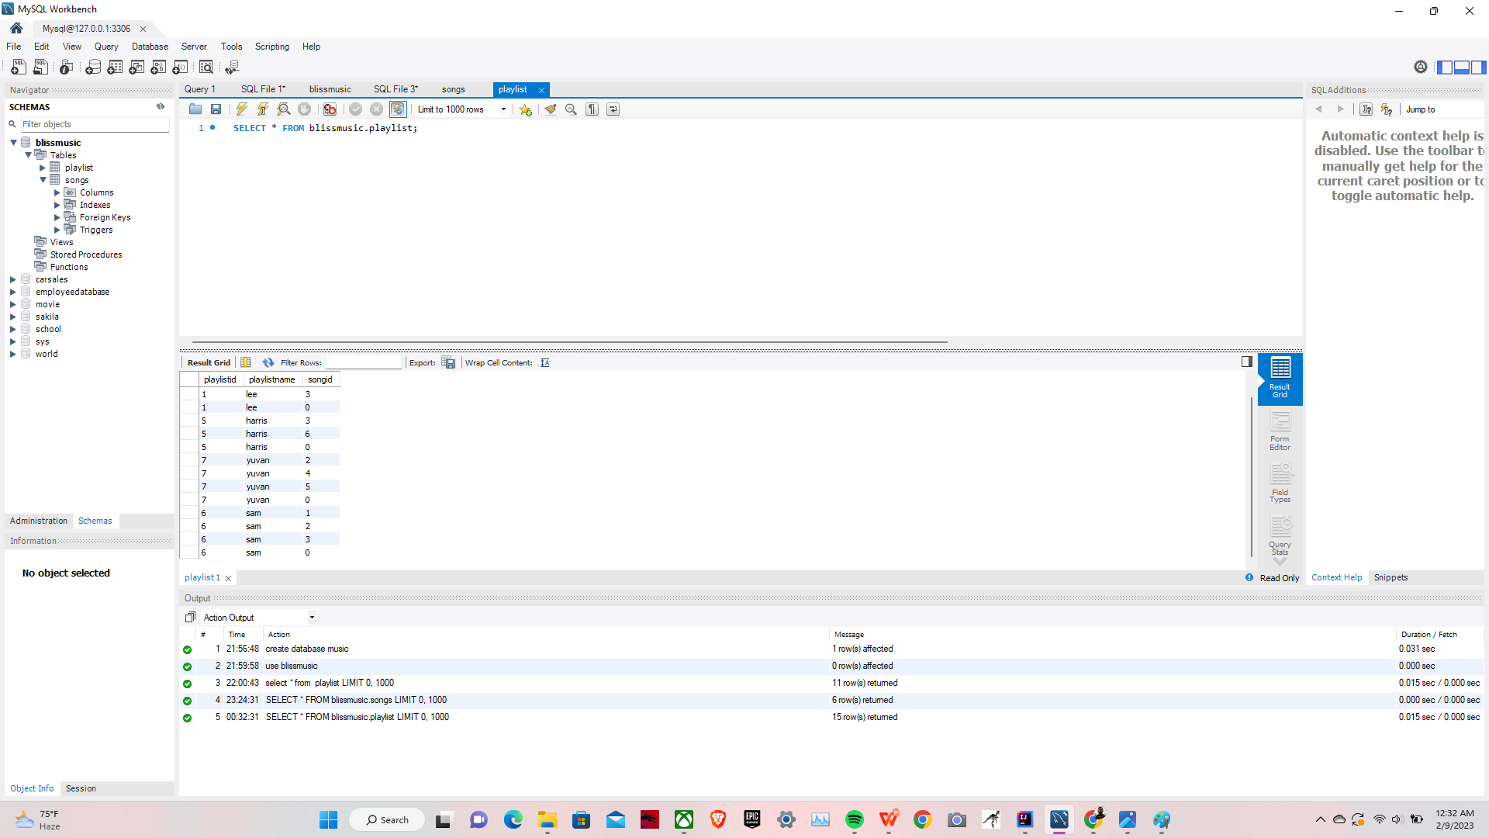
Create Playlist And view Playlist
Create Playlist :
to create playlist and can able to add the fav song of them in the playlist from the given songs,playlist create in my sql.
view the already created playlist.
And can enjoy the songs.
shows example for the image.

Slide 13

Thank You

